Slide 1

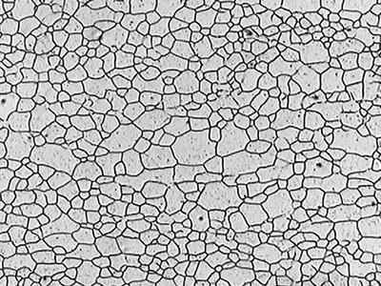
BTP Project (EE 349) 2023-24
Department of Electrical Engineering ,IIT (BHU) Varanasi
GRAIN SIZE ANALYSIS USING PYTHON
Supervised By :
Prof. Dr. Rakesh Kumar Mishra
Submitted By :
Arju(21085010)
Khushboo Chaurasiya(21085039)

Slide 2
Table of Contents
Thresholding
4
1
Introduction
Boundary detection
Masking & Coloring
5
Grain labeling
2
Image Read
Pixel size and each pixel selection
Area Calculation
6
Average grain size
Denoising
7
3
Conclusion
Using filters

Slide 3
Introduction :
Grain size analysis is a crucial aspect in materials science and engineering, providing insights into the microstructure and mechanical properties of various materials. Understanding the size distribution and morphology of grains within a material is fundamental for optimizing its performance in applications ranging from structural materials to pharmaceuticals.
Our project aims to develop a Python-based solution for grain size analysis, offering researchers and engineers a versatile and efficient tool to analyze images of material microstructures. By leveraging image processing techniques and computational algorithms, we provide a systematic approach to extracting grain size information from microscopy images.

Slide 4

SAMPLE GRAIN IMAGE AT MICROSCOPIC LEVEL

Slide 5
STEP 1: IMAGE READING AND PIXEL DETECTION
Image Acquisition: Microscopy images are typically captured using various imaging techniques such as optical microscopy, scanning electron microscopy (SEM), or transmission electron microscopy (TEM), depending on the desired resolution and contrast requirements. These images provide detailed views of the microstructure of materials at a microscopic level.
Reading Microscopy Images: Once the microscopy images are obtained, our Python-based solution allows us to read these images programmatically. We utilize libraries such as OpenCV or scikit-image to reads the image as an ndarray (N-dimensional array). The 0 argument indicates that the image should be read as grayscale. Grayscale images have a single channel representing pixel intensity.
Understanding Pixel Size: Each image is composed of individual picture elements, known as pixels. The resolution of the image is determined by the number of pixels it contains. However, in order to relate features within the image to real-world dimensions,

Slide 6
STEP 1: IMAGE READING AND PIXEL DETECTION
we need to establish the relationship between pixels and physical units, such as microns.
Defining Pixel Size: Pixel size refers to the physical size represented by each pixel in the image. This information is often provided by the imaging equipment or can be determined through calibration procedures. By knowing the pixel size, we can convert measurements made in pixels to real-world units (e.g., microns), enabling us to quantify the dimensions of features within the material microstructure accurately.
Importance of Pixel Size Definition: Defining the pixel size is crucial for ensuring the accuracy and relevance of our analysis results. Without knowing the scale of the image in real-world units, any measurements or calculations performed on the image would lack meaningful interpretation. By establishing the pixel size, we bridge the gap between the digital representation of the image and its physical reality, facilitating quantitative analysis and comparison with experimental data or theoretical models.

Slide 7
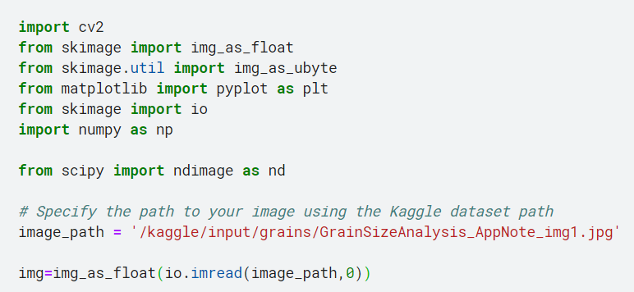

Code…

Slide 8
STEP 2: DENOISING USING FILTERS
In microscopy images, noise can arise due to various factors such as sensor imperfections, lighting variations, or electronic interference. This noise can degrade image quality and affect the accuracy of subsequent analysis. To address this, we employ denoising techniques to remove or reduce unwanted noise while preserving important image features.
Types of Noise: Common types of noise in microscopy images include Gaussian noise, salt-and-pepper noise, and speckle noise. Each type of noise requires specific denoising methods tailored to its characteristics.
Denoising Techniques: We utilize a range of denoising algorithms such as Gaussian smoothing, median filtering, bilateral filtering, or wavelet denoising. These techniques effectively reduce noise while retaining the structural details of the image, ensuring a clearer representation of the material microstructure.

Slide 9
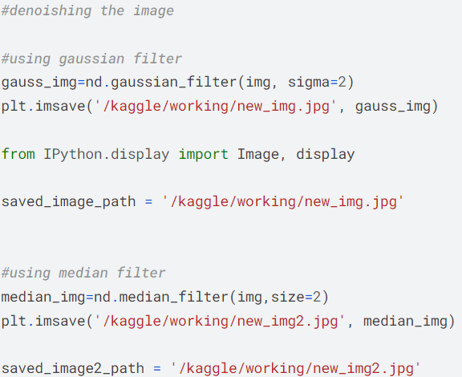
STEP 2: DENOISING USING INDIVIDUAL FILTERS
Gaussian Filter:
Blurs or smoothes images.
weighted average of neighboring pixels, with the weights determined by the Gaussian distribution.
The amount of blurring is controlled by the standard deviation parameter.
Effective for reducing noise while preserving edges.
Median Filter:
Removes noise from images.
Replaces each pixel value with the median value of its neighbors.
Particularly effective for removing "salt and pepper" noise.
Preserves edges and fine details in the image.

Slide 10
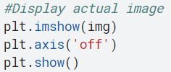


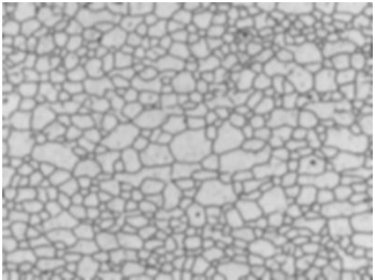
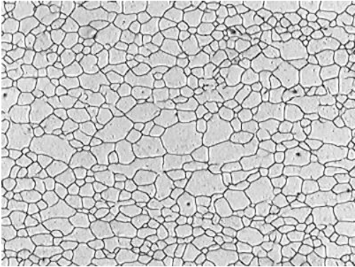
EFFECT OF FILTERS ON IMAGE
IMAGE AFTER USING GAUSSIAN FILTER
ACTUAL IMAGE
IMAGE AFTER USING MEDIAN FILTER

Slide 11
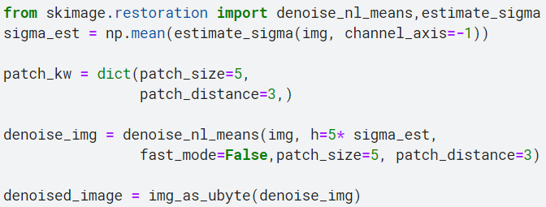
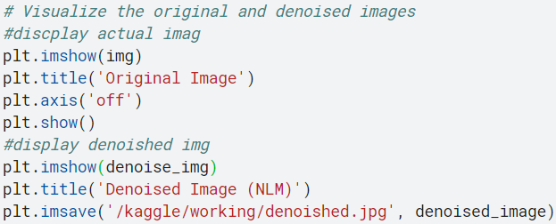
DENOISING USING NLM(Non-Local Means) FILTER
NLM Filter:
Considers global image similarity.
Matches patches for resemblance.
Employs weighted averaging.
Adapts to image content.
Computational complexity may be high.
Applied in medical imaging, photography, and video processing.

Slide 12
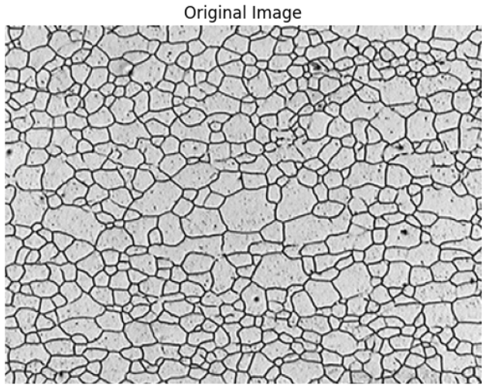
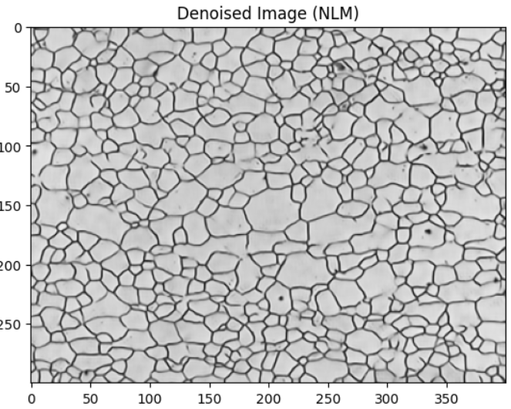
IMAGE AFTER DENOISING USING NLM FILTER
IMAGE AFTER USING NLM FILTER
ACTUAL IMAGE

Slide 13
Thresholding on a gray image is a fundamental image processing technique used to separate objects or regions of interest from the background based on their pixel intensity values. In thresholding, a threshold value is defined, and each pixel in the gray image is compared to this threshold value. Pixels with intensity values above the threshold are classified as foreground (or object), while pixels with intensity values below the threshold are classified as background.
There are different methods for thresholding, including global thresholding, adaptive thresholding, and Otsu's thresholding, each suitable for different scenarios and image characteristics.
STEP 3: IMAGE THRESHOLDING
Otsu’s Thresholding : Otsu's thresholding is a widely used technique for automatic image thresholding, particularly in cases where the histogram of the image is bimodal, meaning it has two peaks corresponding to the foreground and background intensities.It aims to find the optimal threshold value that separates the foreground (object of interest) from the background in an image. It does this by maximizing the between-class variance or minimizing the intra-class variance.

Slide 14
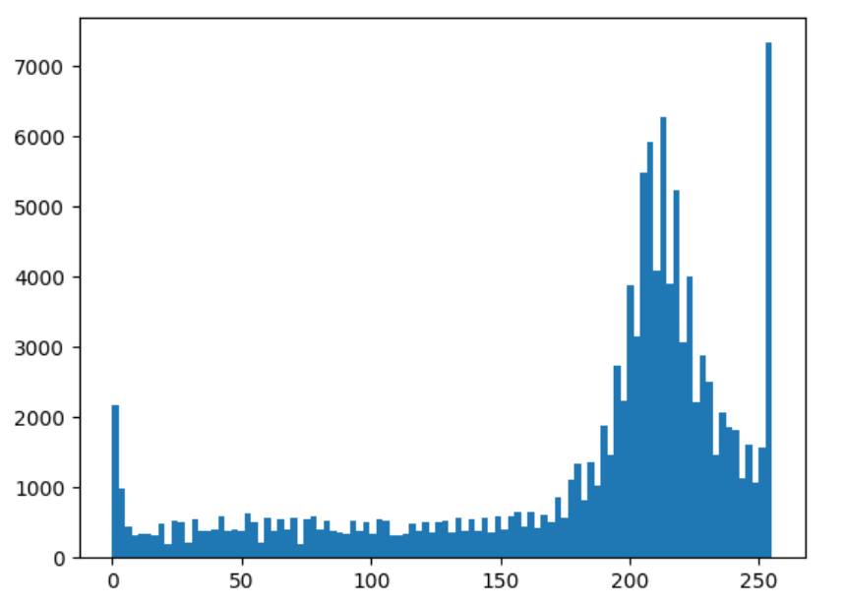
Algorithm:
Otsu's method calculates the histogram of the image, representing the distribution of pixel intensities.
It then iterates through all possible threshold values and calculates the between-class variance for each threshold.
The threshold value that maximizes the between-class variance (or minimizes the intra-class variance) is selected as the optimal threshold.
0:
Pixels with intensity values below the threshold are set to 0.
These pixels typically represent background or regions that do not meet the thresholding criteria.
255:
Pixels with intensity values above the threshold are set to 255.
These pixels typically represent foreground or regions of interest that meet the thresholding criteria.
Distribution Of Pixel Intensities

Slide 15
Masking grainy gray images after thresholding involves using a binary mask to filter out noise or unwanted elements from the image. First, you apply a threshold to convert the gray image into a binary one. Then, we create a mask based on specific criteria, such as retaining larger features and filtering out noise. Finally, we apply this mask to the thresholded image, where areas marked '1' in the mask remain unchanged, while areas marked '0' are filtered out. This results in a clearer image with reduced noise and improved segmentation.
STEP 4: MASKING THE GRAINS
After applying a threshold to the denoised grayscale image , the resulting binary image is subjected to morphological operations - erosion and dilation. These operations help in smoothing and refining the binary image by removing small noise and filling gaps in object contours.
Next, a mask is created by checking where the dilated image has a pixel value of 255. This results in a binary mask where areas of interest are marked with '1' (white) and background or noise areas are marked with '0' (black).

Slide 16
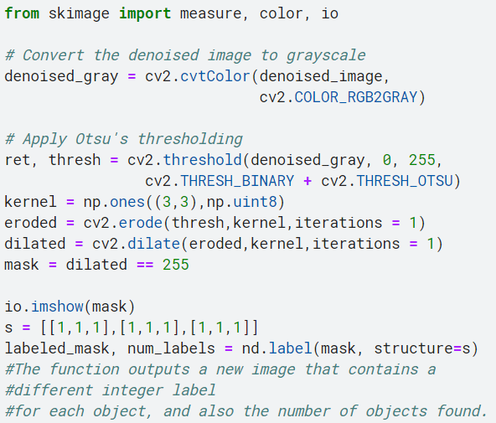
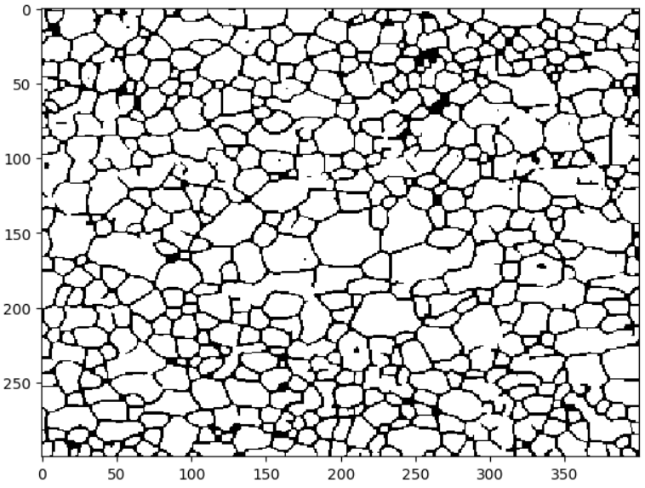

CODE..

Slide 17
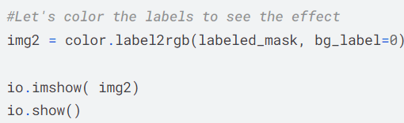
Finally, the labeled mask is generated. This function assigns a unique label to each connected component in the mask, allowing for the identification and analysis of separate objects or regions in the image.
STEP 5: COLORING OF GRAINS
By passing the labeled_mask to the color.label2rgb function, we generate a new image where each labeled region is visually distinguished by a distinct color. The bg_label parameter is used to specify the background label, which often corresponds to unlabeled regions or background areas in the image.

Slide 18
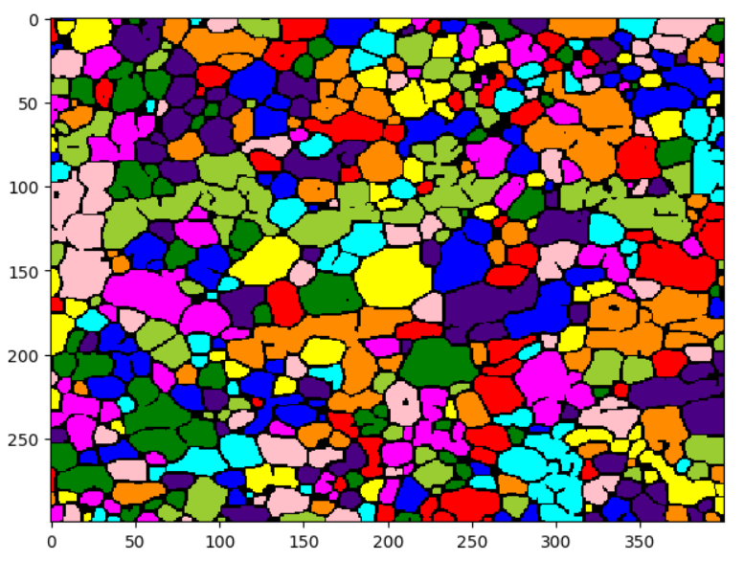
STEP 5: COLORING OF GRAINS
Coloring Labels for Visualization: we enhance the visual representation of labeled regions in the image by assigning distinct colors to each label by utilizing the color.label2rgb function, which is commonly found in libraries like scikit-image. This function is specifically designed to assign unique colors to each label in a labeled image. This process aids in better understanding and interpretation of the segmented regions.

Slide 19
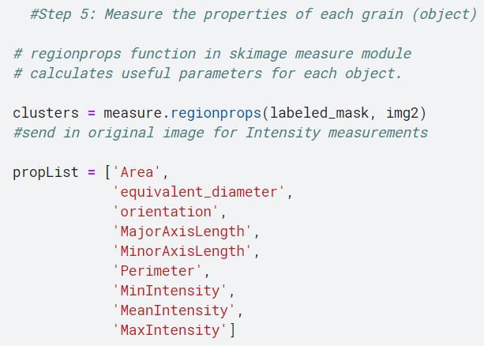
AREA CALCULATIONS…
The regionprops function in the skimage measure module calculates useful parameters for each object. Clusters are created using this function by providing the labeled mask and the original image for intensity measurements. A list of properties of interest, such as area, equivalent diameter, orientation, and intensity statistics, is defined. Assuming a pixel size of 1 square micrometer, the total area of all clusters is computed by iterating through each cluster and summing up the areas. Finally, the average area is determined by dividing the total area by the number of clusters.

Slide 20
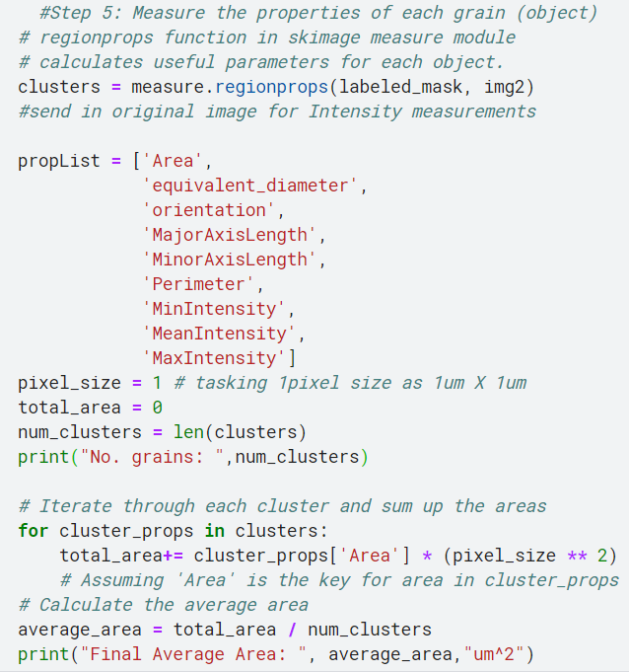
AREA CALCULATIONS…
FINAL RESULT FOR THE SAMPLE IMAGE

Slide 21
CONCLUSION
In summary, the model provides a holistic approach to processing and analyzing microscopy images, with a specific focus on material microstructures. By utilizing a diverse range of denoising algorithms including Gaussian smoothing, median filtering, bilateral filtering, non-local means (NLM) filtering, and wavelet denoising, the model effectively reduces noise while preserving crucial structural details. This ensures that the resulting images accurately portray the material microstructure, facilitating further analysis. Additionally, the model incorporates techniques for defining pixel size and label coloring for visualization, enabling both quantitative analysis and qualitative inspection of microscopic features. Overall, the model serves as a robust solution for researchers and practitioners, enabling efficient and accurate extraction of insights from microscopy images.

Slide 22
H
N
T
A
K
Y
U
O

